Slide 1

Virtual Moderator
17-428/728 Final Project Presentation
Jett Hays | Chih-Wei Fang | Di Lu

Slide 2
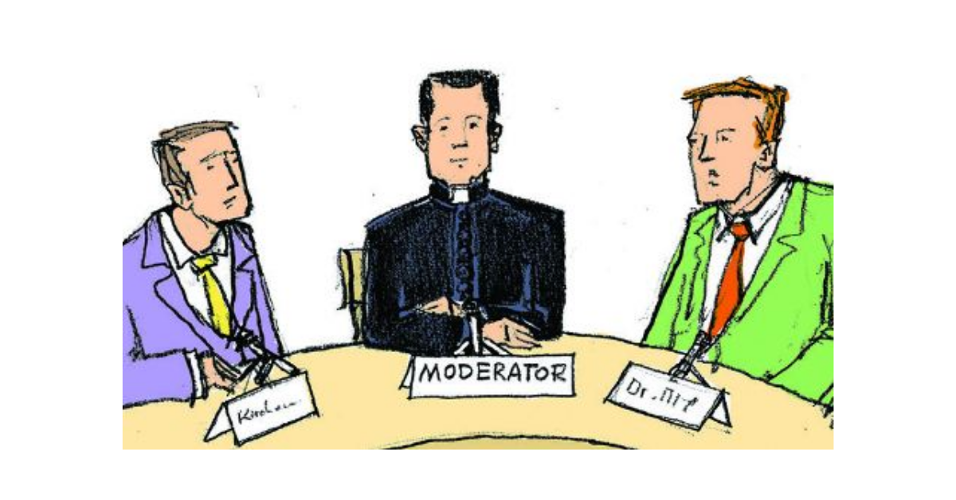
Introduction of virtual moderator
moderator:
Should be able to:
Someone who leads a conversation between a group of people, but does not take any side in it:
Also makes certain that a conversation goes smoothly follows the standard rules:
Recognize different speakers;
Identify and report volume, speed, duration, tone of speech from one specific speaker and generate prompt information(volume up/speed down…..)
Make truth judgments and generate a truth score
Topics involved:
Speech Diarization
KNN clustering
Streaming Recognize
Speech recognition
NLP and Crawling

Slide 3
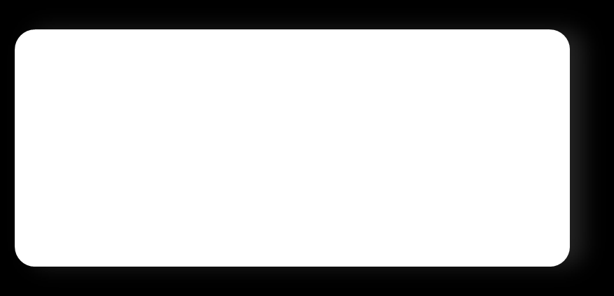

Objective
Duration
Volume
Goal:
Improve conversations by quantifying what you say and how you say it.
Tone
WPM

Slide 4
System Flow
Metrics for moderator
Conversation
Features
Display
Diarization
Identification
Model

Slide 5
Diarization Anatomy and Realization: Segmentation
speaker-discriminative features
Scaler: MaxAbsScaler()
Trim trailing silence: librosa.effects.trim(), <40dB, 1Sec
1）Normalize and Preprocess
2）Detection:
remove noise and non-speech
3）Segmentation
extract short segments
4）Embedded Feature Extraction:
generate representation of each segment
5）Cluster in Real-time and label:
determine speaker numbers and assign segments.
Sliding window:
splits single audio sample into multiple samples of window size
LibROSA ( a python package for music and audio analysis)
Mfcc
chroma_stft
melspectrogram
SpectralCluster:
Gaussian blur /

Slide 6
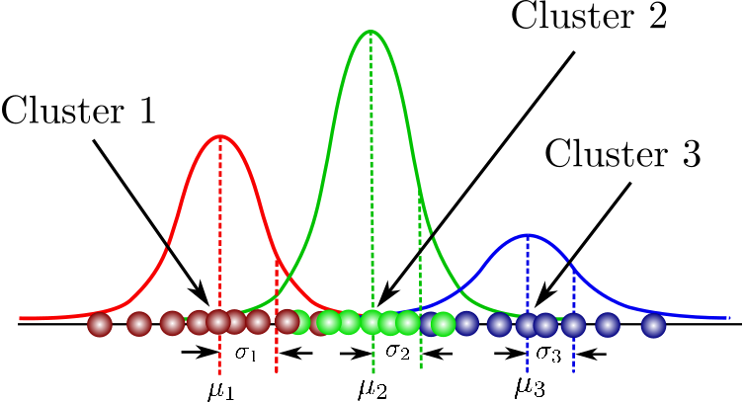
Diarization Anatomy and Realization: Clustering

Slide 7
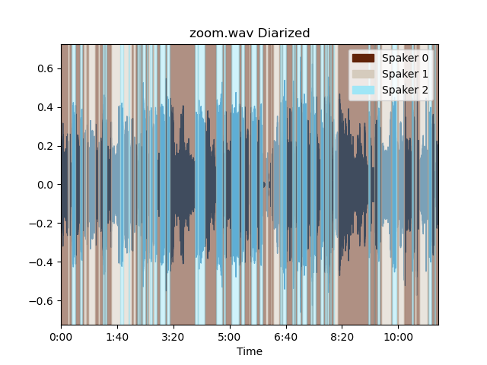
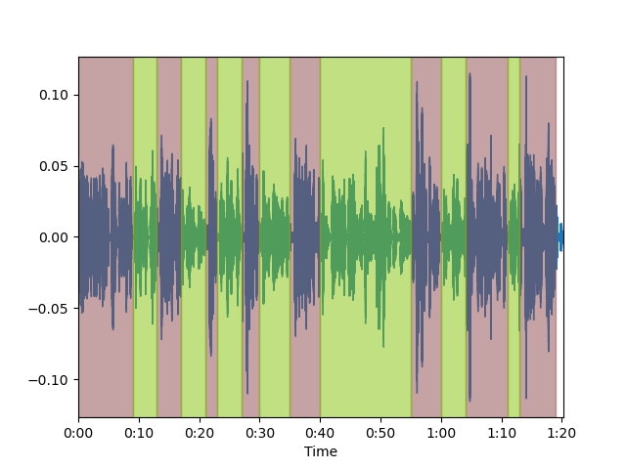
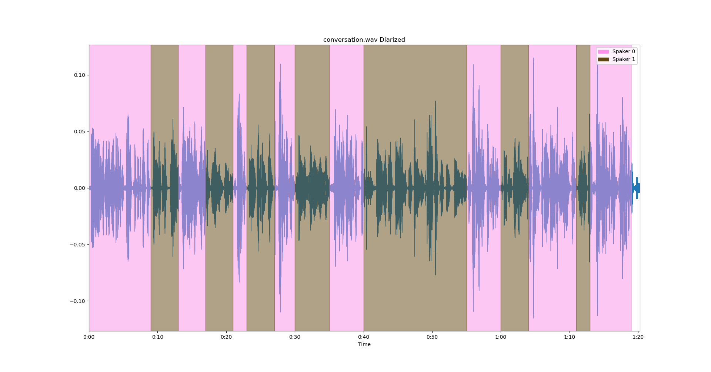
Example Segments

Slide 8
Speaker Identification: GMM
Calculate score
Provide sample
Audio sample 0.1s-0.15s
Speaker 1
GMM 1
Audio sample 0.15s-0.17s
Speaker 2
GMM 2
Audio sample 0.17s-0.2s
Speaker 3
GMM 3
Audio sample 0.2s-0.25s
Audio sample 0.25s-0.28s

Slide 9
Metrics
Duration
Volume
Tone
WPM

Slide 10
Metrics: Emotion
Audio sample 0.1s-0.15s
Score for:
Neutral?
Calm?
Happy?
Sad?
Angry?
Fear?
Disgust?
Surprise?
Audio sample 0.15s-0.17s
Audio sample 0.17s-0.2s
Classifier
Audio sample 0.2s-0.25s
Audio sample 0.25s-0.28s
Trained a classifier using RAVDESS emotional speech dataset (24 actors, ~1500 clips) https://www.kaggle.com/uwrfkaggler/ravdess-emotional-speech-audio
Each clip is split into 25ms windows and select MFCC as features
Results: {'KNeighborsClassifier(n_neighbors=10)': 0.9257007133964216, 'KNeighborsClassifier(n_neighbors=20)': 0.8699715905706629}

Slide 11
Metrics: Recommendations
'Mayank Goel is a professor of machine learning and sensing at Carnegie Mellon.’
Related Topics:
machine learning and sensing cmu
machine learning professor Stanford
machine learning sensing
machine learning and sensing lab
adaptive sensing machine learning

Slide 12
Demo.
Virtual Moderator
Jett Hays | Chih-Wei Fang | Di Lu

Slide 13
Future development
1) More accuracy in distinguishing speakers with similar voices.
Speaker identification models are extremely easy to become biased, for example 1) if silence is introduced in the training data 2) if the volumes across speakers are different. When training the identification model, the system should pre-process the incoming data.
2) Users could label the clusters themselves.
The speaker identification is based purely on models trained only once before use. The system should allow users to label the clusters by themselves and further improve the model. Or just ask user about low-confidence predictions so we reach semi-supervised learning.
3) More efficient metrics calculation
If we introduce more metrics that depend on machine learning techniques, then we need to introduce parallelism in order to keep the system working in real time.
4) More complex truth judgment and more language supporting
Language can be switched using Google speech recognition package.
Different language may have different tone, WPM standards.
Work on NLP further and be to split complex sentences into judgable ones.

Slide 14
Thank you.
Virtual Moderator
Jett Hays | Chih-Wei Fang | Di Lu

